Slide 1
PrintNet T Triple Suite
Workflow Overview

Slide 2
Agenda
Workflow
Building a Workflow
What Makes a Good Workflow?

Slide 3

1. Workflow

Slide 4

Workflow – Introduction
Contains all of the elements of a print job:
  Data Input Definitions
  Data Processing Definitions
  Layout Definitions
  Impositioning Definitions
  Output Definitions
Notes:
Data Input: Using external data files as input for your PrintNet T job.
Data Processing: Applying changes to the format and organization of your data (e.g., sorting, grouping, converting, etc.).
Layout: Organizing and designing your actual print job.
Impositioning: Arranging your finalized layout pages for printing on print sheets (e.g., rotating, two pages per print sheet, etc.).
Output: Defining your printing output type (e.g., PDF, AFP, etc.).

Slide 5
Context Schema
Workflow
Data Input
&
Manipulation
Document
Design
(Layout)
Impositioning
Approval (Proof)
Spool Production
Notes:
A workflow includes five major module types: Data Input; Data Processing (manipulation); Layout (design); Impositioning; and finally, Output.
Proof is not part of the workflow itself, although it is used frequently through the course of creating a workflow in order to see what a document will look like when it comes out of the printer.

Slide 6
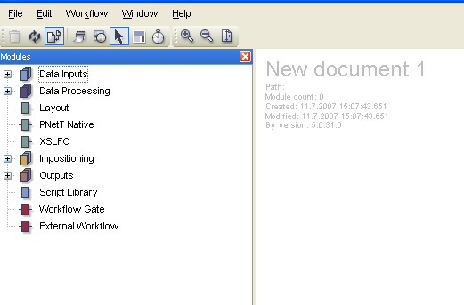
Workflow Screen
Notes:
The left part of the workflow view window contains a list of available modules.
The right part of the workflow view window is used to build and structure your workflow.
The modules from the left can be dragged and dropped into the main workflow window.

Slide 7


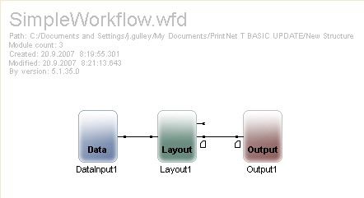
Simple Workflow – Example
Notes:
A simple workflow has only one input, one layout, and one output.
While it is possible to complete an entire job using just the layout module alone, the most basic workflow that is commonly used is the simple workflow with one input, one layout, and one output.

Slide 8
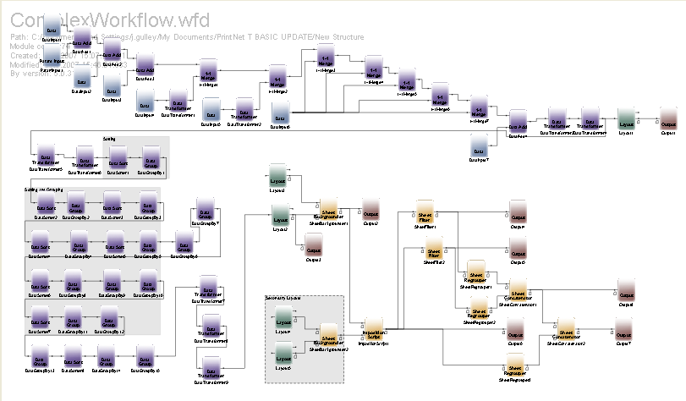
Complex Workflow – Example
Notes:
A more complex workflow can have more than one input, more than one layout, or more than one output.
A workflow may use more than one input to draw in data: for example, one data input might be from a database of customer names and a second data input might draw in data from an accounts or transaction database.
A workflow can also include multiple layouts in the example of a letter and envelope piece where the envelope gets the name and address printed on it; both layouts are driven by the same data stream(s).

Slide 9

2. Building a Workflow

Slide 10

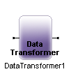



Modules of Workflow
There are five main categories of workflow modules:
Data Inputs (blue)
Data Processing (purple)
Layout (green)
Impositioning (yellow)
Outputs (red)

Slide 11
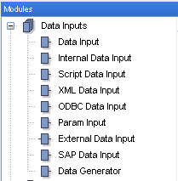
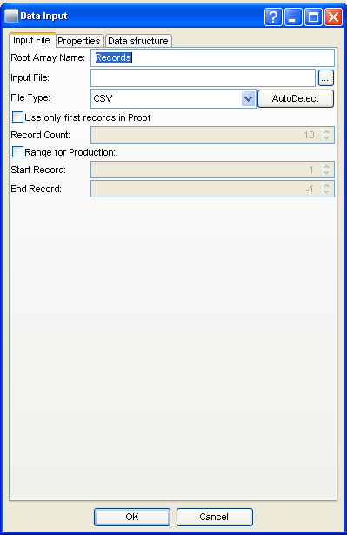
Data Inputs

Slide 12
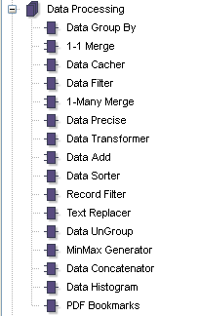
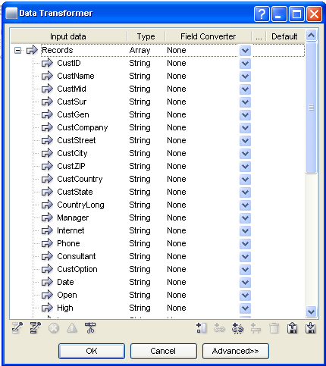
Data Processing

Slide 13
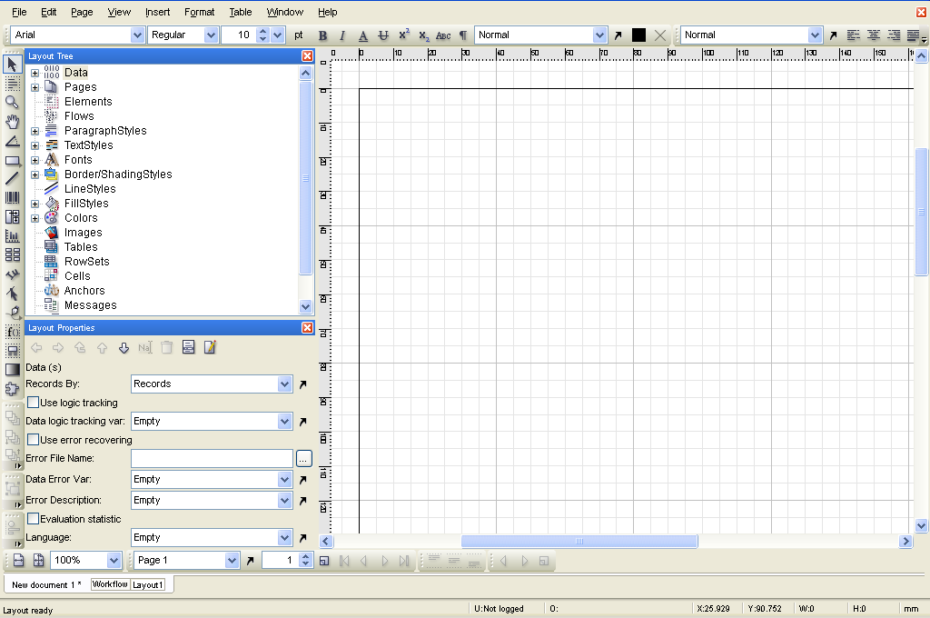
Layout

Slide 14
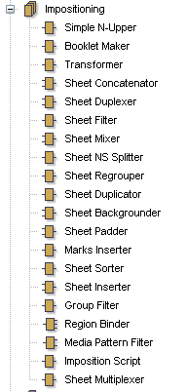
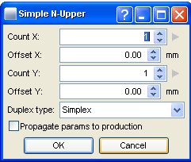
Impositioning

Slide 15
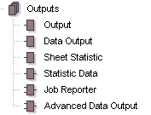
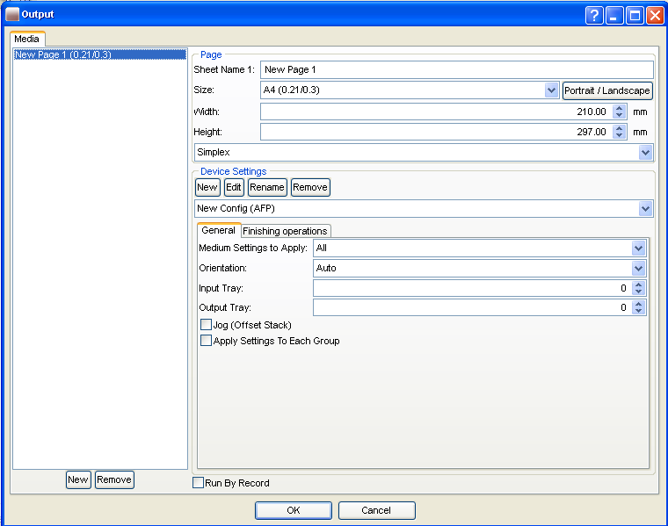
Output

Slide 16

3. What Makes a Good Workflow?

Slide 17
What Makes a Good Workflow?
  The components are placed in a linear, left-to-right format
  Each element of the workflow is named (with a descriptive, function based name)
  Each section of the workflow is labeled
  Easy to follow and read
  Can be used by another person without explanation
Notes:
Modules should be placed in the workflow in the logical, left-to-right format. As workflows get more complex, this may be difficult to achieve, but the same principles should apply.
Renaming your modules is a good habit that you should begin right away. Naming your modules allows other people to view your workflow and understand the logic and order without needing to speak to you.
Labels are another way to quickly distinguish larger sections of a workflow from other larger sections.
At all times, your workflow should strive to be as understandable as possible to any hypothetical person who may need to view it in the future.

Slide 18
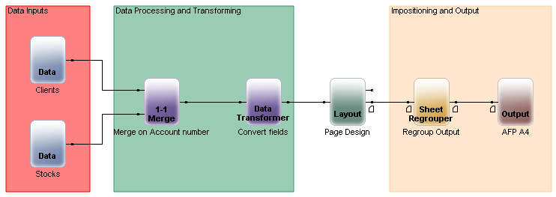
Good Workflow – Example

Slide 19

Thank You.
Do You Have Any Questions?

